Slide 1
CHAPTER THREE
Fundamentals of Computer Networks

Slide 2


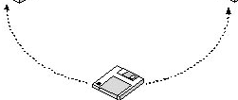
Overview of Computer Networks-----
Old paradigm:
A single powerful computer serving all the needs of an organization
Sneaker net --Method of sharing data by copying it to a disk and carrying it from computer to computer
New paradigm
Computer networks: a large number of separate (autonomous) but internetworked (being able to exchange information) computers doing the job

Slide 3
Overview of Computer Networks-----
Merging of computer and communications technologies – no geographical barrier
Connection: copper wire, fiber optics, microwaves, infrared, communication satellites, …
A computer network is an interconnected collection of autonomous computers
Interconnected meaning two or more computers have the,
ability to exchange information and sharing resources using
some transmission media
e.g., copper cabling, fiber optics, or radio wave and etc.

Slide 4
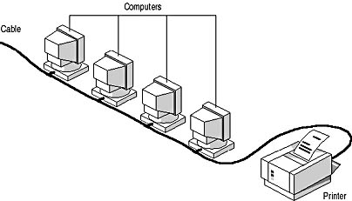
Contd.
Autonomous meaning where no one computer controls any other computer (i.e. no computer can forcibly start or stop another computer)
Computers can be PC’s, workstations, server computers and internetworking devices such as hubs, switches and routers
The computers can be geographically located anywhere

Slide 5
Contd.
Two computers are said to be interconnected if they are able to exchange information or sharing of resources
Components of a compute networks
Hardware:
Computer
Network card
Routers
Modem …
Media:
Cable
Wire
Microwave …
Software:
Network OS
Utilities …
Network Design:
Logical layout
Physical layout …

Slide 6
Application or uses of Computer Networks
 | Application | Descriptions and Examples
1 | Resource Sharing | Hardware( Computing resources, disks, printers…) Software (Application software, mainly databases on central servers),
2 | Communication | e-mail, newsgroups, chat room, Internet telephony, videoconferencing
3 | Home Applications | User-to-User Communication, Entertainment, E-Commerce,
4 | Business Applications | business to business - placing orders, … business with consumers–home shopping

Slide 7
Application or uses of Computer Networks-----
 | Application | Descriptions and Examples
5 | Social Media | It helps people in getting news, feed, current trending topics of all types, etc.
6 | Access to Remote Information | It helps in accessing remote information from the end-users. For Example, details required for train tickets, plane tickets, etc
7 | Cloud Computing | Allows users to store and access data and applications from remote servers
8 | Virtualization | Allows multiple virtual machines to run on a single physical machine, improving resource utilization and reducing costs.

Slide 8
Application or uses of Computer Networks-----
 | Application | Descriptions and Examples
9 | Online Education | Online learning platforms, distance education, and virtual classrooms.
10 | Remote Working | Allowing employees to work from home or other locations outside of the office. Especially important during the COVID-19 pandemic.
11 | E-commerce | Facilitated the growth of e-commerce by allowing businesses to sell their products and services online and reach a global market.

Slide 9
Application or uses of Computer Networks-----
 | Application | Descriptions and Examples
12 | Real-time Collaboration | Networking technologies enable real-time collaboration, allowing people to work together on projects and share information in real-time, no matter where they are located.
13 | Telemedicine | Networking technologies have also enabled telemedicine, allowing doctors and healthcare providers to provide remote medical consultations and diagnosis to patients in remote locations.

Slide 10
Limitations of Networks
Security Issues
Data & information held on a network is open to many people across the world, and can easily be accessed illegally.
In addition, when information is sent over the network from one place to another,
it can be tapped or listened to by unauthorized parties.
This is leads to the danger of important and
sensitive information fall on the hands of hostile party
Virus and Malware
Networking can lead to the spreading of viruses to
another computer through the network.

Slide 11
Limitations of Networks------
2. High initial cost
The initial cost of buying network hardware & software is very high.
3. Moral and cultural effects
Large networks such as the Internet have chat rooms and messaging services.
These enable underage children to meet peers and adults on the net, some of whom may have bad intentions.
Access to pornographic and other negative material on the Internet has made the fight against social problems such as
HIV/AIDS, bad sexual behaviour, and drug abuse more complicated.

Slide 12
Limitations of Networks------
4. Spread of terrorism and drug trafficking
The Internet makes it easy for terrorists and drug traffickers to operate.
This is because; they use information networks for their business communications.
5. Over-reliance on networks
Most organizations have done away with manual operations.
This means that, all business processes, and the society depend on computer networks.
Therefore, if by any chance the network fails or goes down, then many systems in the society will stop working.

Slide 13
Limitations of Networks------
6. Management of the network
Management of the Network is quite difficult as it requires highly qualified and skilled persons to handle that large network.
It requires training of people who are employed in this work.

Slide 14
Types of Network
The size of a network should be expressed by the geographic area and number of computers, which are a part of their networks.
It includes devices housed in a single room to millions of devices spread across the world.
There are basically four categories of networks based on its size and geographical coverage
Personal Area Network(PAN)
Local Area Network (LAN)
Metropolitan Area Network (MAN)
Wide Area Network (WAN)

Slide 15
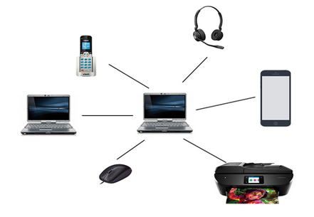
1. Personal Area Network(PAN)
PAN (Personal Area Network) is a computer network formed around a person.
It generally consists of a computer, mobile, or personal digital assistant.
PAN can be used for establishing communication among these personal devices for connecting to a digital network and the internet.

Slide 16
1. Personal Area Network(PAN)------
Personal Area Network covers an area of 30 feet.
Personal computer devices that are used to develop the personal area network are the laptop, mobile phones, media player and play stations.
There are two types of Personal Area Network:
Wired Personal Area Network
Wireless Personal Area Network
1. Wireless Personal Area Network:
Wireless Personal Area Network is developed by simply using wireless technologies such as WiFi, Bluetooth.
It is a low range network.

Slide 17
1. Personal Area Network(PAN)------
2. Wired Personal Area Network:
Wired Personal Area Network is created by using the USB.
Examples Of Personal Area Network:
A. Body Area Network:
Body Area Network is a network that moves with a person.
For example, a mobile network moves with a person.
Suppose a person establishes a network connection and then creates a connection with another device to share the information.

Slide 18
1. Personal Area Network(PAN)------
B. Offline Network:
An offline network can be created inside the home, so it is also known as a home network.
A home network is designed to integrate the devices such as printers, computer, television but they are not connected to the internet.
C. Small Home Office:
It is used to connect a variety of devices to the internet and to a corporate network using a VPN

Slide 19
Characteristics of PAN
It is mostly personal devices network equipped within a limited area.
Allows you to handle the interconnection of IT devices at the surrounding of a single user.
PAN includes mobile devices, tablet, and laptop.
It can be wirelessly connected to the internet called WPAN.
Appliances use for PAN: cordless mice, keyboards, and Bluetooth systems.

Slide 20
Advantages and Disadvantages of PAN
Advantages of PAN
PAN networks are relatively secure and safe
It offers only short-range solution up to ten meters
Strictly restricted to a small area
Disadvantages of PAN
Here are the cons/drawbacks of using PAN network:
It may establish a bad connection to other networks at the same radio bands.
Distance limits.

Slide 21
2. Local Area Network (LAN)
A local area network (LAN) is the basic building block of any computer network.
A LAN can range from simple (two computers connected by a cable) to complex (hundreds of connected computers and peripherals throughout a major corporation).
The distinguishing feature of a LAN is that it is confined to a limited geographic area.
A local area network (LAN) is usually privately owned and links the devices in a single office, building, or campus.

Slide 22
2. Local Area Network (LAN)-----
A Local Area Network (LAN) is a group of computer and peripheral devices which are connected in a limited area such as school, laboratory, home, and office building.
It is a widely useful network for sharing resources like files, printers, games, and other application.
The simplest type of LAN network is to connect computers and a printer in someone’s home or office.
In general, LAN will be used as one type of transmission medium.
It is a network which consists of less than 5000 interconnected devices across several buildings.

Slide 23
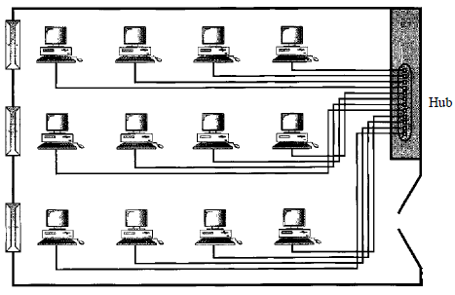
2. Local Area Network (LAN)-----

Slide 24
2. Local Area Network (LAN)-----
Characteristics of LAN
It is a private network, so an outside regulatory body never controls it.
LAN operates at a relatively higher speed compared to other WAN systems.
There are various kinds of media access control methods like token ring and ethernet.
Advantages of LAN
Computer resources like hard-disks, DVD-ROM, and printers can share local area networks.
This significantly reduces the cost of hardware purchases.

Slide 25
2. Local Area Network (LAN)-----
You can use the same software over the network instead of purchasing the licensed software for each client in the network.
Data of all network users can be stored on a single hard disk of the server computer.
You can easily transfer data and messages over networked computers.
It will be easy to manage data at only one place, which makes data more secure.
Local Area Network offers the facility to share a single internet connection among all the LAN users.

Slide 26
2. Local Area Network (LAN)-----
Disadvantages of LAN
LAN will indeed save cost because of shared computer resources, but the initial cost of installing Local Area Networks is quite high.
The LAN admin can check personal data files of every LAN user, so it does not offer good privacy.
Unauthorized users can access critical data of an organization in case LAN admin is not able to secure centralized data repository.
Local Area Network requires a constant LAN administration as there are issues related to software setup and hardware failures

Slide 27
3. Wide area networks (WAN)
WAN (Wide Area Network) is another important computer network that which is spread across a large geographical area.
WAN network system could be a connection of a LAN which connects with other LAN’s using telephone lines and radio waves.
It is mostly limited to an enterprise or an organization.
A WAN can be as complex as the backbones that connect the Internet or as simple as a dial-up line that connects a home computer to the Internet.

Slide 28
3. Wide area networks (WAN)--------
We normally refer to the first as a switched WAN and to the second as a point-to-point WAN
The switched WAN connects the end systems, which usually comprise a router (internetworking connecting device) that connects to another LAN or WAN.
The point-to-point WAN is normally a line leased from a telephone or cable TV provider that connects a home computer or a small LAN to an Internet service provider (lSP).
This type of WAN is often used to provide Internet access.

Slide 29
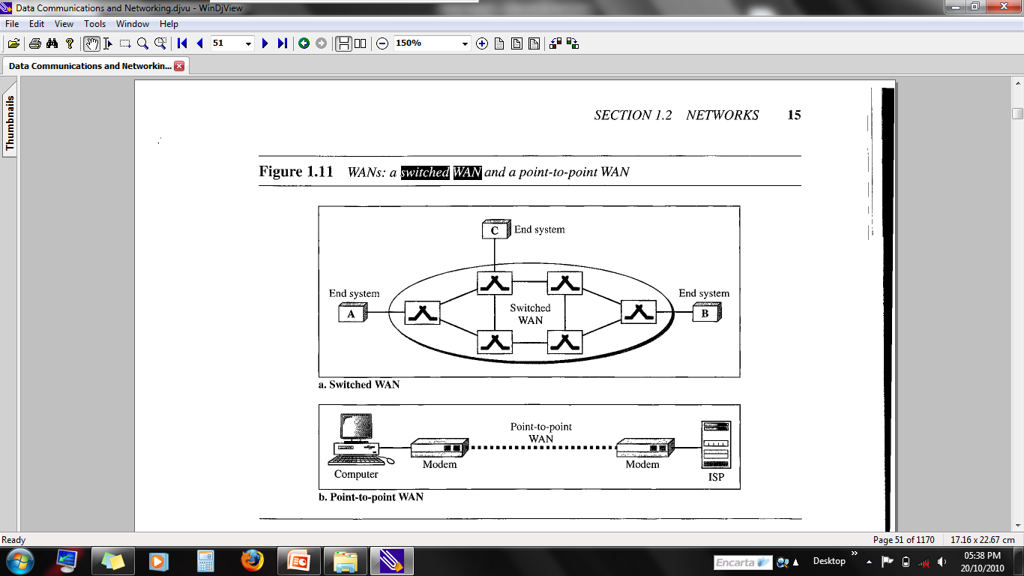
3. Wide area networks (WAN)---

Slide 30
3. Wide area networks (WAN)--------
Characteristics of WAN
The software files will be shared among all the users; therefore, all can access to the latest files.
Any organization can form its global integrated network using WAN.
Advantages of WAN
WAN helps you to cover a larger geographical area. Therefore business offices situated at longer distances can easily communicate.
Contains devices like mobile phones, laptop, tablet, computers, gaming consoles, etc.

Slide 31
3. Wide area networks (WAN)--------
WLAN connections work using radio transmitters and receivers built into client devices.
Disadvantages of WAN
The initial setup cost of investment is very high.
It is difficult to maintain the WAN network. You need skilled technicians and network administrators.
There are more errors and issues because of the wide coverage and the use of different technologies.
It requires more time to resolve issues because of the involvement of multiple wired and wireless technologies.
Offers lower security compared to other types of network in computer.

Slide 32
4. Metropolitan Area Network(MAN)
A metropolitan area network (MAN) is a network with a size between a LAN and a WAN.
It normally covers the area inside a town or a city.
It is designed for customers who need a high-speed connectivity, normally to the Internet, and have endpoints spread over a city or part of city.
A good example of a MAN is the part of the telephone company network that can provide a high-speed DSL line to the customer.
Another example is the cable TV network that originally was designed for cable TV, but today can also be used for high-speed data connection to the Internet.

Slide 33
4. Metropolitan Area Network(MAN)
A Metropolitan Area Network or MAN is consisting of a computer network across an entire city, or a small region.
This type of network is large than a LAN, which is mostly limited to a single building or site.
Depending upon the type of configuration, this type of network allows you to cover an area from several miles to tens of miles.
Uses Of Metropolitan Area Network:
MAN is used in communication between the banks in a city.
It can be used in an Airline Reservation.
It can be used in a college within a city.
It can also be used for communication in the military.

Slide 34
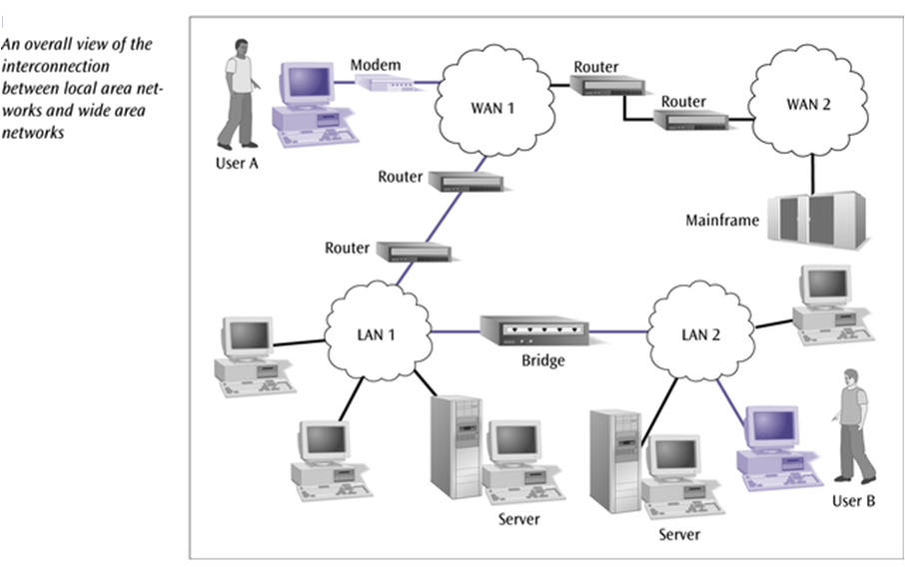
Interconnection of Networks: Internetwork
Today, it is very rare to see a LAN, a MAN, or a LAN in isolation; they are connected to one another.
When two or more networks are connected, they become an internetwork, or internet.

Slide 35
4. Metropolitan Area Network(MAN)
Characteristics of MAN
It mostly covers towns and cities in a maximum 50 km range
Mostly used medium is optical fibers, cables
Data rates adequate for distributed computing applications.
Advantages of MAN
Here are the pros/benefits of MAN network:It offers fast communication using high-speed carriers, like fiber optic cables.
It provides excellent support for an extensive size network and greater access to WANs.
The dual bus in MAN network provides support to transmit data in both directions concurrently.
A MAN network mostly includes some areas of a city or an entire city.
Disadvantages of MAN
You need more cable to establish MAN connection from one place to another.
In MAN network it is tough to make the system secure from hackers

Slide 36
Network and Internet
A network is a group of connected communicating devices such as computers and printers.
An internet (note the lowercase letter i) is two or more networks that can communicate with each other.
The most notable internet is called the Internet (uppercase letter I), a collaboration of more than hundreds of thousands of interconnected networks.
Private individuals as well as various organizations such as government agencies, schools, research facilities, corporations, and libraries in more than 100 countries use the Internet.

Slide 37
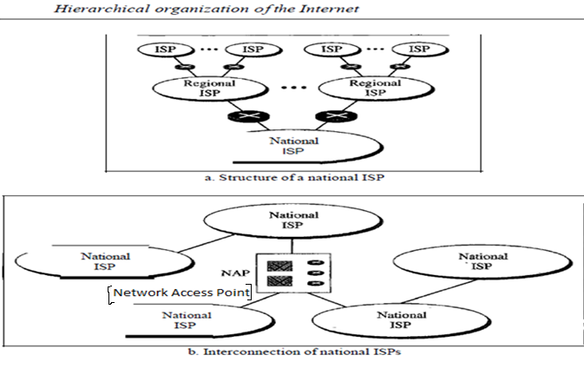

Slide 38
Network Type based on connection
A network is two or more devices connected through links.
A link is a communications pathway that transfers data from one device to another.
For visualization purposes, it is simplest to imagine any link as a line drawn between two points.
For communication to occur, two devices must be connected in some way to the same link at the same time.
There are two possible types of connections: point-to-point and multipoint.

Slide 39
1. Point-to-Point
A point-to-point connection provides a dedicated link between two devices.
The entire capacity of the link is reserved for transmission between those two devices.
Most point-to-point connections use an actual length of wire or cable to connect the two ends, but other options, such as microwave or satellite links, are also possible.
When you change television channels by infrared remote control, you are establishing a point-to-point connection between the remote control and the television's control system.

Slide 40
2. Multipoint
A multipoint (also called multidrop) connection is one in which more than two specific devices share a single link.
In a multipoint environment, the capacity of the channel is shared, either spatially or temporally.
If several devices can use the link simultaneously, it is a spatially shared connection.
If users must take turns, it is a timeshared connection.

Slide 41
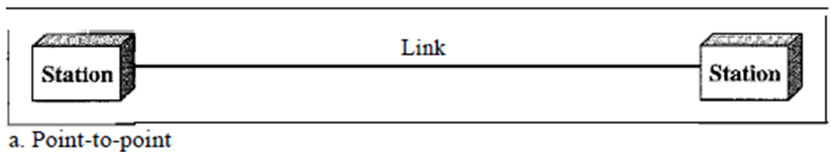
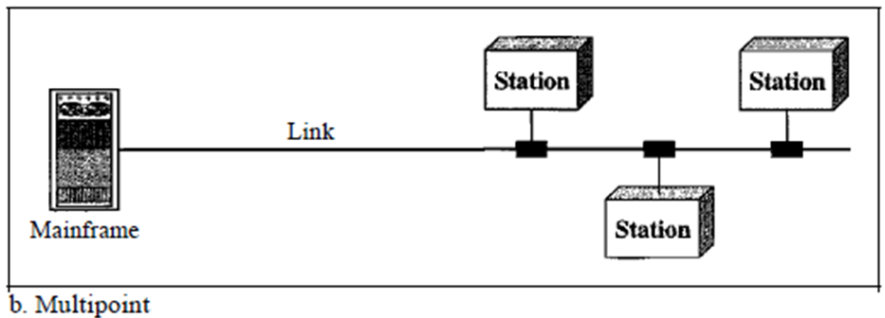

Slide 42
Network Topology
A network topology is the pattern of links connecting pairs of nodes of a network.
Topology is about the physical connection of devices
Network topology is determined only by the configuration of connections between nodes
Distance between nodes, physical interconnections, transmission rates, and/or signal types are not a matter of network topology
The term topology refers to the way in which a network is laid out physically.

Slide 43
Network Topology
Two or more devices connect to a link; two or more links form a topology.
The topology of a network is the geometric representation of the relationship of all the links and linking devices (usually called nodes) to one another.
There are four basic topologies possible:
Star Topology
Bus Topology
Ring Topology
Mesh Topology

Slide 44
Network Topology------
Bus Topology
A bus topology, is multipoint connection.
One long cable acts as a backbone to link all the devices in a network
Bus Topology is a network Topology in which a set of nodes are connected via a shared communications line, called a bus
Bus networks are the simplest way to connect multiple clients
Often bus networks have problems when two clients want to transmit at the same time on the same bus.

Slide 45
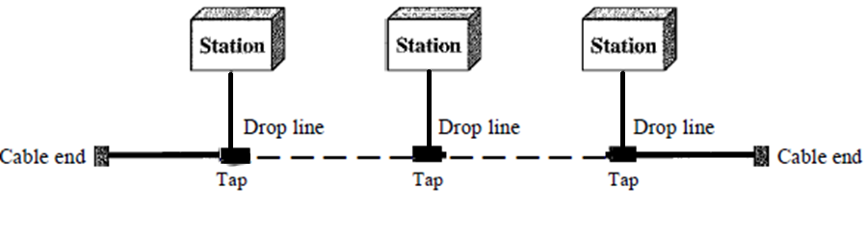
Network Topology------
Systems which use bus topology normally have some scheme of collision handling or collision avoidance for communication on the bus
Carrier Sense Multiple Access with Collision Detection (CSMA/CD) is one such solution

Slide 46
Bus Topology------
Advantages
Simple to build the network
Backbone cable can be laid along the most efficient path, then connected to the nodes by drop lines of various lengths.
In this way, a bus uses less cabling than mesh or star topologies.
In a star, for example, four network devices in the same room require four lengths of cable reaching all the way to the hub.
In a bus, this redundancy is eliminated. Only the backbone cable stretches through the entire facility.
Each drop line has to reach only as far as the nearest point on the backbone.
Easy to add new devices
Failure of a single machine has no impact on the network

Slide 47
Bus Topology------Advantages
In a bus, this redundancy is eliminated. Only the backbone cable stretches through the entire facility.
Each drop line has to reach only as far as the nearest point on the backbone.
Easy to add new devices
Failure of a single machine has no impact on the network

Slide 48
Disadvantage
Very difficult to scale.
Unsecured – can easily be tapped
If the central bus is broken, the network will be disrupted
Difficult reconnection and fault isolation.
A bus is usually designed to be optimally efficient at installation.
Signal reflection at the taps can cause degradation in quality.
This degradation can be controlled by limiting the number and spacing of devices connected to a given length of cable.

Slide 49
Disadvantage--------
Adding new devices may therefore require modification or replacement of the backbone.
In addition, a fault or break in the bus cable stops all transmission, even between devices on the same side of the problem.
The damaged area reflects signals back in the direction of origin, creating noise in both directions.

Slide 50
2. Star Topology
In a star topology, each device has a dedicated point-to-point link only to a central controller, usually called a hub or switch.
This is the most common topology in use today
The term dedicated means that the link carries traffic only between the two devices it connects.
The devices are not directly linked to one another.
Unlike a mesh topology, a star topology does not allow direct traffic between devices.
The controller acts as an exchange:

Slide 51
2. Star Topology ------
If one device wants to send data to another, it sends the data to the controller, which then relays the data to the other connected device
A star topology is less expensive than a mesh topology.
In a star, each device needs only one link and one I/O port to connect it to any number of others.
This factor also makes it easy to install and reconfigure.
Far less cabling needs to be housed, additions, moves, and deletions involve only one connection: between that device and the hub/switch.

Slide 52
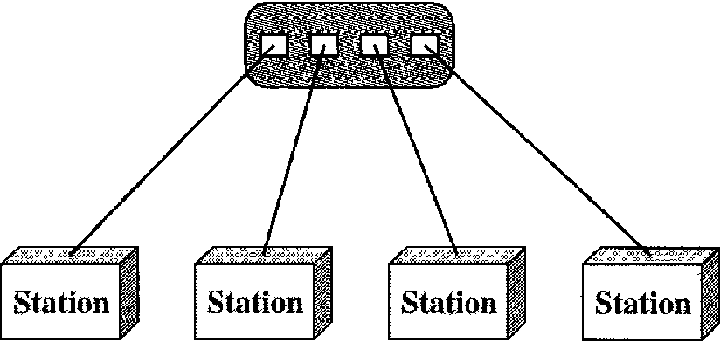
The star topology is used in local-area networks (LANs).
High-speed LANs often use a star topology with a central hub/switch
Star topology

Slide 53
ADVANTAGES OF Star Topology
Management of the network is centralized around the hub and switch components.
It is easy to build and configure the network
It is also easy to include additional nodes without disturbing the entire network
A failure of a given node has no effect on the network

Slide 54
DISADVANTAGES OF Star Topology
One big disadvantage of a star topology is the dependency of the whole topology on one single point, the hub.
If the hub goes down, the whole system is dead.
Although a star requires far less cable than a mesh, each node must be linked to a central hub.
For this reason, often more cabling is required in a star than in some other topologies (such as ring or bus).

Slide 55
3. Ring Topology
In a ring topology, each device has a dedicated point-to-point connection with only the two devices on either side of it.
A signal is passed along the ring in one direction, from device to device, until it reaches its destination.
Each device in the ring incorporates a repeater.
When a device receives a signal intended for another device, its repeater regenerates the bits and passes them along

Slide 56
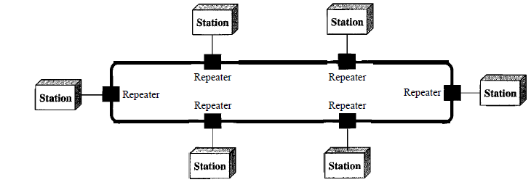
Ring topology

Slide 57
3. Ring Topology------
A ring is relatively easy to install and reconfigure.
Each device is linked to only its immediate neighbors (either physically or logically).
To add or delete a device requires changing only two connections.
The only constraints are media and traffic considerations (maximum ring length and number of devices).
In addition, fault isolation is simplified.

Slide 58
3. Ring Topology------
Generally in a ring, a signal is circulating at all times.
In a simple ring, a break in the ring (such as a disabled station) can disable the entire network.
This weakness can be solved by using a dual ring or a switch capable of closing off the break.
Ring topology was prevalent when IBM introduced its local-area network Token Ring.
Today, the need for higher-speed LANs has made this topology less popular.

Slide 59
ADVANTAGES OF Ring Topology
Data is quickly transferred without a ‘bottle neck’.
Transmission of data is relatively simple as packets travel in one direction only.
Adding additional nodes has very little impact on bandwidth
It prevents network collisions because of the media access method

Slide 60
disadvantages OF Ring Topology
Data packets must pass through every computer between the sender and recipient .Therefore this makes it slower.
If any of the nodes fail then the ring is broken and data cannot be transmitted successfully.
It is difficult to troubleshoot the ring.
Because all stations are wired together, to add a station you must shut down the network temporarily.
All computers must be turned ON in order for all computers to communicate with each other.

Slide 61
4. Mesh Topology
A type of topology in which every device or computer is connected to every other device.
Each device not only sends its signals but also receives signals from other devices.
The nodes in a mesh topology are connected using a dedicated link and the information is passed from nodes to nodes.
This topology has N * (N - 1) / 2 links in total where N represents the total number of nodes.
The connections within the mesh can be wired as well as wireless.

Slide 62
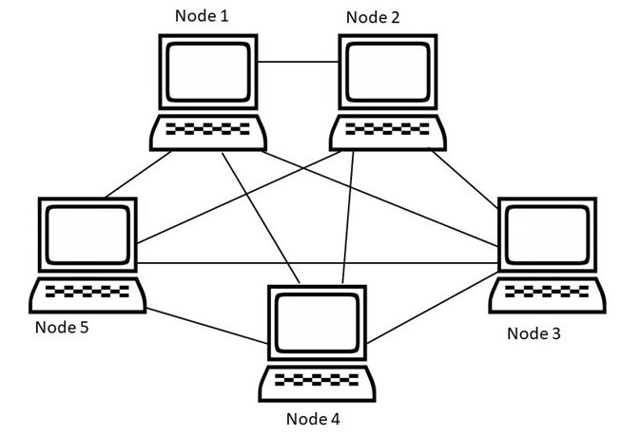
Mesh Topology

Slide 63
Types of Mesh Topologies
Fully connected mesh topology
Partially connected mesh topology
1. Fully connected mesh topology
All the nodes in a mesh topology are connected with every other node.
If there are N number of nodes during a network then each node will be connected with other N - 1 nodes.
The mesh topology can deal with redundancy with excellence.
The only disadvantage of using a full connected mesh topology is that it is costly to implement.

Slide 64
Types of Mesh Topologies
2. Partial mesh topology
The partial mesh topology is more advanced as compared to full mesh.
It is not mandatory for all the nodes to be connected with each other during a partial mesh topology.
It is less expensive as compared to full mesh topology.

Slide 65
Advantages and Disadvantages of Mesh Topology
No | Advantages | Disadvantages
1 | Very easy to add a new device | Initial setup is very difficult.
2 | High level of traffic is manageable by it after the completion of the setup. | Implementing cost for mesh topology comparatively higher
3 | Scalability is simple. | Compared to other, it is very costly
4 | Addition of new devices does not affect the network. | There is high risk of redundant connection
5 | Data transmission is consistent. | Additional cost is required for each node
6 | A malfunction in one device does not disturb the connection. | Latency issues are very common
7 | There is no need for a central hierarchy. | It has complex structure.
8 | Without a complete set of web, it can operate simply | Power consumption of Mesh Topology is more than the other topologies.

Slide 66
5. Hybrid Topology
A hybrid topology is a topology that combines two or more other topologies, to put it simply.
However, a combination of technologies is needed for its physical counterpart.
As a result, hybrid topology provides a suitable complicated structure.
It has advantages for enhancing flexibility.
It has the ability to improve fault tolerance and enable the easy addition or removal of fundamental topologies.

Slide 67
5. Hybrid Topology-----
Hybrid topology is more frequently employed when you need to fulfil a range of computer networks.
All network segments in this topology include the configuration of many network topologies.
You may create a hybrid web composed of two additional networks as an example.
They are the ring and star backbones, respectively.
Hybrid Topology helps in keeping the full diversity of the computer network.
Hybrid Topology is helpful when we require more than one topology in the system.

Slide 68
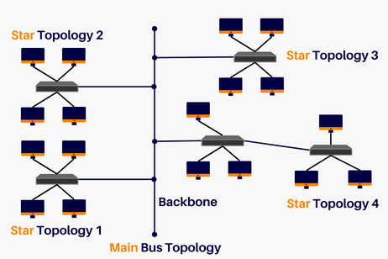
5. Hybrid Topology-----
Hybrid Topology helps in reducing the cost of the overall system.
Hybrid Topology helps in easily running the system.
Hybrid Topology is widely used in educational institutes, research organizations, finance sectors, etc.

Slide 69
What are the Advantages of Hybrid Topology?
No | Advantages | Description
1 | Reliability | The hybrid topology is the most dependable and secure networking structure. Hybrid systems provide very quick mistake detection, which makes troubleshooting very simple. Because it incorporates sub-networks, the network topology as a whole has a very high level of dependability. Because networks are sub-branched, if one network malfunctions or stops operating, the total network is unaffected by this and continues to function. Because of its higher fault tolerance, the branching mechanism limits the impact of a defect on how networks function.

Slide 70
What are the Advantages of Hybrid Topology?
No | Advantages | Description
2 | Efficiency | The hybrid structure's total efficacy is considerably increased as a result of the mixing of multiple topologies, which not only strengthens the networks' strengths but also balances out their weaknesses. Hybrid star-ring topology may be created by combining the characteristics of both topologies, for instance, a ring topology with high reliability and a star topology with high tolerance.
3 | Reliable Data Link | As a result of the hybrid topology's use of two separate topological networks' properties, data transport via a hybrid network is incredibly quick and reliable. The total effectiveness and efficiency of the networks in a hybrid architecture won't be impacted by interference between various nodes.

Slide 71
What are the Advantages of Hybrid Topology?
No | Advantages | Description
4 | Adaptability | Since the overall configurations and adjustments may be planned and built in accordance with the needs of the users and the organizations that maximize the overall resources of the networks, hybrid topology gives excellent flexibility in usage. Thus, the topology is designed to support the characteristics and its utilization in order to use it in various networking contexts. Because of its characteristics, which include several extension points to link, the kind of network may be readily extended.

Slide 72
What are the Advantages of Hybrid Topology?
No | Advantages | Description
5 | Secure Transmission Method | When a threat or error occurs in the system, the whole network is not impacted, improving security and debugging capabilities. The separation of the defective components improves fault tolerance, and the current topologies don't need to be changed in order to create a hybrid topology.
6 | Scalability | The hybrid network's excellent scalability is one of its best qualities. The construction of hybrid networks enables us to integrate several branch-like networking connection points. Regardless of the network's size, the hardware components are added or withdrawn extremely effectively, and new network components are quickly supplied without affecting the design or branching system as a whole.

Slide 73
What are the Advantages of Hybrid Topology?
No | Advantages | Description
 |  | Regardless of the network's size, the hardware components are added or withdrawn extremely effectively, and new network components are quickly supplied without affecting the design or branching system as a whole.

Slide 74
What are the Disadvantages of Hybrid Topology?
No | Disadvantages | Description
1 | Complex Design | Making a hybrid network requires a lot of work from the network technicians of topologies because network design is so intricate. Due to the intricate structure of topology, network processing becomes quite complicated
2 | High Costs | Building a network using hybrid architecture demands a significant investment in time and money. The usage of these resources is expensive and sensitive. It is more expensive than others since it must be purchased again after being destroyed in order to build a better network.

Slide 75
What are the Disadvantages of Hybrid Topology?
No | Disadvantages | Description
3 | Installation Challenges | Setting up a big and complicated hybrid topology network is an extremely challenging operation. Nodes and the cable network need to be configured systematically. To create such a massive network connection system, the employees must have the necessary skills.
4 | More Hardware Requirement | The hybrid topologies employ a greater variety of hardware. Installation is challenging due to the complexity of the topology and the nodes' connections, and connecting many nodes necessitates using several cables.
5 | Cable Failures | Failures of the main backbone cable might occasionally have an impact on not only the linked topologies but also the whole network.

Slide 76
Network Models by Capability
1. Client/Server Model
Microcomputer users, or clients, share services of a centralized computer called a server.
Type of network in which particular computers— servers—are responsible for resources and providing these resources for other computers— clients.
There can be many clients and one server, or vice versa.
Servers can have one specific type of resource to control.

Slide 78
Client/server network
The main focus of the Client-Server Network is on information sharing.
However, the server can distribute its resources such as computing power or hard drive space with the network.
Client-Server Network is more scalable and stable.
In order to store data in a client-server network, a centralized server is used.
Data backup and protection are made simpler by centralised file storage.
In Client-Server Network, client and server are distinct, and there are particular servers and clients.

Slide 79
Client/server network-------
In Client-Server Network, the client requests a service, and the server provides it.
It costs a lot of money to implement client-server.
A separate computer must be used to serve as the server, and because a server needs more processing power, a high-performance machine is necessary.
The access time for a service is longer in client-server networks because more client's requests services from a server.

Slide 80
Client/server network
If the number of clients increases, there are no performance issues with the client-server setup.
This is because the server handles most of the heavy lifting and the clients are not needed to share their computing resources.
When compared to peer-to-peer networks, client-server networks are far more secure.
This is due to the server's ability to authenticate a client's access to any network resource.

Slide 81
Client/server network------
The clients in a client-server network reply on the server.
The operation of every client will be interfered with if the server fails.
Hence it is unreliable.
It costs a lot of money to implement client-server.
A separate computer must be used to serve as the server, and because a server needs more processing power, a high-performance machine is necessary.
The access time for a service is longer in client-server networks because more client's requests services from a server.

Slide 82
1. Client/Server-----
Pros:
Very secure
Centralized servers easy to manage
Physically centralized
Secure NOS
Better performance
Centralized backups
Reliability- simple job to do plus built in redundancy

Slide 83
1. Client/Server-----
Cons:
Central servers can be pricey to buy and maintain.
The overall set-up cost of a client-server network is also high.
A client-server network requires a great level of expertise from network technicians to configure and manage both the server hardware and software.
The central server's failure will probably disrupt all computers or other devices across the client-server network

Slide 84
2. Peer-to-Peer Model
Computers share equally with one another without having to rely on a central server.
Type of network where all the computers are equal and therefore are known as peers.
Normally, each computer functions as both a client and a server, and there is no one assigned to be an administrator responsible for the entire network.
The user at each computer determines what data on their computer gets shared on the network

Slide 85
The main focus of the peer-to-peer groups is on connectivity.
We can mostly find it in small offices and homes where centralized access to files or services is unnecessary.
In a peer-to-peer network, every pair contains its own data, and the server is decentralized.
It is less expensive to implement the peer-to-peer network.
The simplest peer-to-peer networks can be created by connecting two computers to other using an Ethernet cable.
If the number of peers increases then, the peer-to-peer network would be less stable,

Slide 86
In this network, the client and server cannot be distinguished.
In a peer-to-peer network, each node is able to request and respond to the services.
Compared to a client-server network, the peer-to-peer network is less secure, and it becomes trickier if the number of clients increases.
In a peer-to-peer network, there are multiple services-providing nodes hence it is more reliable.

Slide 87
Since all resources in a peer-to-peer network are shared, performance issues are quite likely to arise in the case of a large number of clients.
Because the service-providing nodes in a peer-to-peer network are dispersed, the service-requesting nodes do not have a wait very long.

Slide 88
2. Peer-to-Peer Model-------

Slide 89
2. Peer-to-Peer (p2p)-----
Computers on the network communicate with each others as equals and each computer is responsible for making its own resources available to other computers on the network.
Pros:
Uses less expensive computer networks
Easy to administer
No NOS (network operating system) required
More built-in redundancy
Shared resources – some machine will have what you need
Cons:
Individual user performance easily affected
Not very secure
Tragedy of the commons – no guarantee others will administer their resources properly (almost guaranteed with over 10 machines)
Hard to back up.
Because security is managed by individual computers, not on the network as a whole, peer-to-peer networks are typically less secure.
Each computer needs its own backup system and anti-virus software. This may add to the overall cost of running a peer-to-peer network.
Performance and system-wide services provided may be slower since each computer carries out more than one task and can be accessed by other computers.

Slide 90
Client-Server network vs Peer-to-Peer Network
No. | Client-Server Network | Peer-to-Peer Network
1 | Clients and servers are distinguished because of the distinctive servers and clients present. | Both clients and servers are not distinguished in Peer-to-Peer Network
2 | It majorly concentrates on sharing the information. | It majorly concentrates on the connectivity part.
3 | Mainly prefer the centralised server to keep the data. | Here, every peer stores its own data.

Slide 91
Client-Server network vs Peer-to-Peer Network
No | Client-Server Network | Peer-to-Peer Network
4 | It is expensive as compared to the Peer-to-Peer network. | It is affordable as compared to the Client-Server network.
5 | More stable network form. | Comparatively less stable.
6 | Used both in small and large networks. | It is mostly preferred for short networks.
7 | In the case of the Client-Server network, the server replies to the services which are asked by the client. | In the case of a Peer-to-Peer network, every node can accomplish both request and response.

